Slide 1
Decision Structures

Slide 2
Relational Operators
Used to compare numbers to determine relative order
Operators:
Operator | Meaning
> | Greater than
< | Less than
>= | Greater than or equal to
<= | Less than or equal to
== | Equal to
!= | Not equal to

Slide 3
Relational Expressions
Boolean expressions – true or false
Examples:
12 > 5 is true
7 <= 5 is false
if x is 10, then
x == 10 is true,
x != 8 is true, and
x == 8 is false

Slide 4
Logical Operators
Operator | Meaning
&& | Logical AND
|| | Logical OR
! | Logical NOT
Logical expression : An expression that combines two or more relational expressions

Slide 5
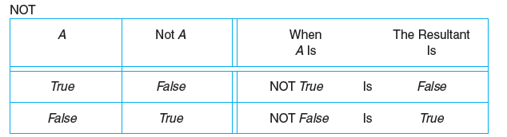
Definitions of the Logical Operators

Slide 6
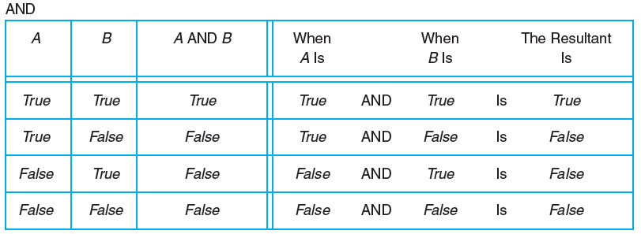
Definitions of the Logical Operators

Slide 7
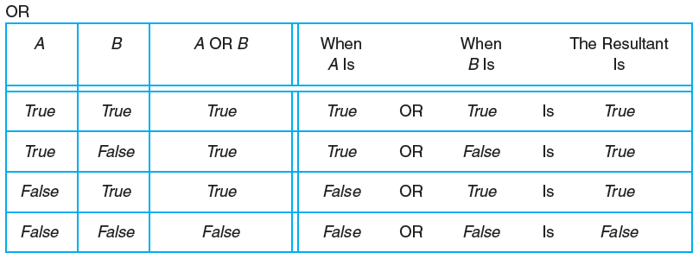
Definitions of the Logical Operators

Slide 8
Logical Operators - examples
int x = 10, y = 9, z = 12
(x<z) && (z>y) | True
(x > y) && (z < y) | False
(x <= z) || (y == z) | True
(x <= z) || (y != z) | True
!(x >= z) | True
(x > z) || (x>y) && (z > y) | True

Slide 9
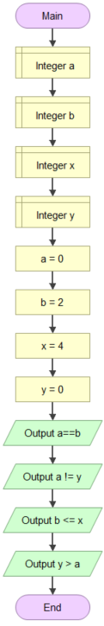
Example: use flowgorithm to verify the outputs.

Slide 10
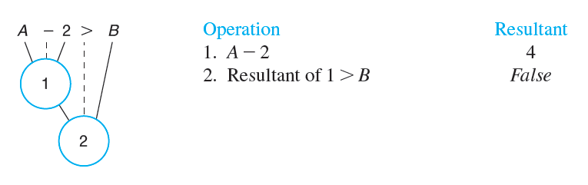
Evaluating a Relational Expression
Suppose A=6 and B=5

Slide 11
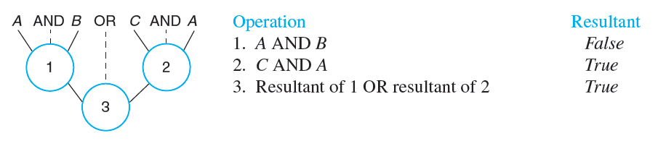
Evaluating a Logical Expression

Slide 12
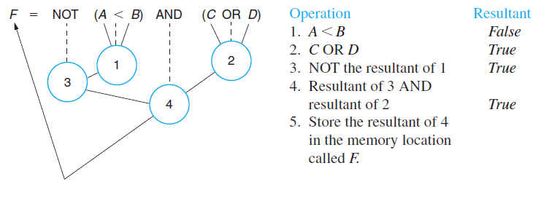
Evaluating an Equation That Uses Both Relational and Logical Operators

Slide 13
The if Statement (Selection Structure)
Allows statements to be conditionally executed or skipped over
Used to choose among alternative courses of action
Pseudocode:
If ( student’s grade is >= 60 ) then Print “Passed”
If condition true
Print statement executed and program goes on to next statement
If false, print statement is ignored and the program goes onto the next statement

Slide 14
The if Statement (Selection Structure)
Diamond symbol (decision symbol)
Indicates decision is to be made
Contains an expression that can be true or false
Test the condition, follow appropriate path
if structure is a single-entry/single-exit structure
true
grade >= 60
print “Passed”
false

Slide 15
The if/else Selection Structure
If (condition) then
Only performs an action if the condition is true
If (condition) then /else
Specifies an action to be performed both when the condition is true and when it is false
if (expression)
statement1; // or block
else
statement2; // or block
Pseudocode:
If (student’s >= 60) then Print “Passed”
else Print “Failed”
• If the expression is true, then statement1 is executed and statement2 is skipped.
• If the expression is false, then statement1 is skipped and statement2 is executed.

Slide 16
The if/else Selection Structure
Flowchart
false
true
grade >= 60
print “Failed”
print “Passed”

Slide 17
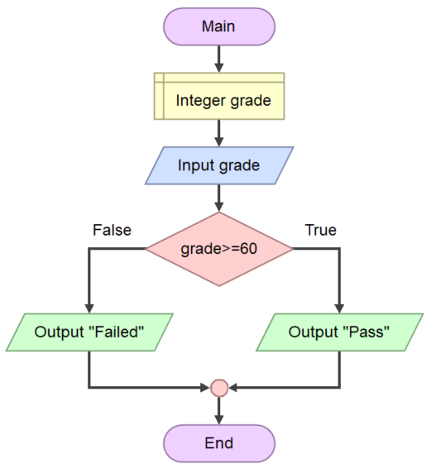
The if/else Selection Structure

Slide 18
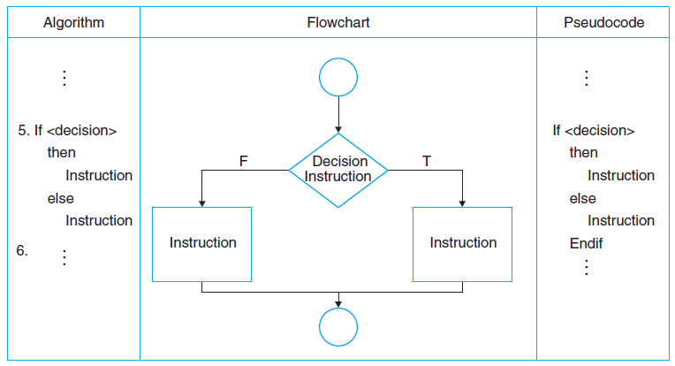
If statement

Slide 19
Exercise 5.1
Writhe the pseudocode and draw the flowchart for a program that asks a user for 2 numbers, num1 and num2. Then num1 is divided by num2 and the result is displayed.
Before the division operation, num2 is tested for the value 0. if it contains 0, the division does not take place.

Slide 20
Exercise 5.2
Writhe the pseudocode and draw the flowchart to determine if the number entered by the user is odd or even

Slide 21
The if/else if Statement
Chain of if statements that test in order until one is found to be true
Also models thought processes:
– “If it is raining, take an umbrella,
else, if it is windy, take a hat,
else, take sunglasses”

Slide 22
if/else if … else format
if (expression)
statement1; // or block
else if (expression) statement2; // or block
.
. // other else ifs
.
else if (expression)
statement n; // or block
else
statement n+1; // or block

Slide 23
Exercise 5.3
Write an algorithm to find the largest among three different numbers entered by user.

Slide 24
Exercise 5.4
Write a pseudocode and draw a flowchart to read temperature in centigrade and display a suitable message according to temperature state below :
Temp < 0 then Freezing weather Temp 0-10 then Very Cold weather Temp 10-20 then Cold weather Temp 20-30 then Normal in Temp Temp 30-40 then Its Hot Temp >=40 then Its Very Hot
Test Data : 42 Expected Output : Its very hot.

Slide 25
Exercise 5.5
Write a pseudocode and draw a flowchart to calculate and print the Electricity bill of a given customer. The customer id., name and unit consumed by the user should be taken from the keyboard and display the total amount to pay to the customer. The charge are as follow :
Unit | Charge/unit
upto 199 | @1.20
200 and above but less than 400 | @1.50
400 and above but less than 600 | @1.80
600 and above | @2.00

